Slide 1
Amnesic Cache Management for Non-Volatile Memory
2017.07.02
DC Lab
서영근
Distributed Computing Laboratory in SKKU

Slide 2
Content
Introduction & motivation
Design
REF
SACM
AACM
Evaluation
Conclusion
Distributed Computing Laboratory in SKKU

Slide 3
Introduction & motivation
Non-Volatile Memory
PCM (Phase Change Memory), STT-RAM (Spin Transfer Torque RAM), ReRAM (Resistive RAM), Fe-RAM (Ferroelectric Random Access Memory)
Byte addressability and Non-Volatility
Limited retention capability, relaxation write
결국 비휘발성의 특징도 매우 장기적인 시각에서 휘발성이라는 뜻
Distributed Computing Laboratory in SKKU

Slide 4
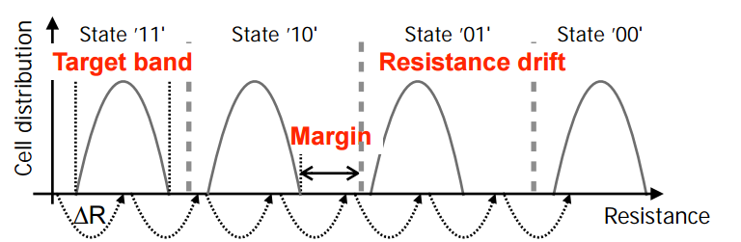
Introduction & motivation
PCM (Phase Change Memory)
target band : A region of resistances that corresponds to valid bits
margin : between target band and boundary
resistance drift
The resistance in a PCM cell has a tendency to increase by time
When the resistance drifts up to the boundary of the next region, the state can be incorrectly represented leading to data loss
Distributed Computing Laboratory in SKKU

Slide 5
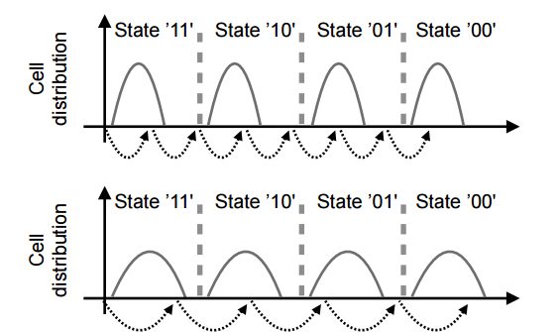
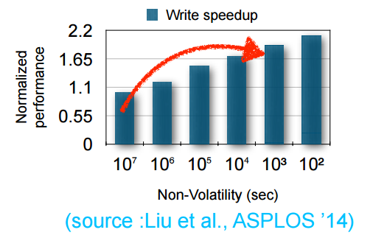
Introduction & motivation
Tradeoff between retention capability and write speed
target band 를 줄이면 resistance drift 가능성이 줄지만 그 만큼 margin이 늘어나 write latency가 늘어난다.
Higher retention increasing write latency
Distributed Computing Laboratory in SKKU

Slide 6
Introduction & motivation
NVM cache
Fetching/Eviction data from/to storage system
Retention capability for the cache
10⁷ seconds is recommended retention capability from JEDEC
But, data will be evicted from the NVM cache
Distributed Computing Laboratory in SKKU

Slide 7
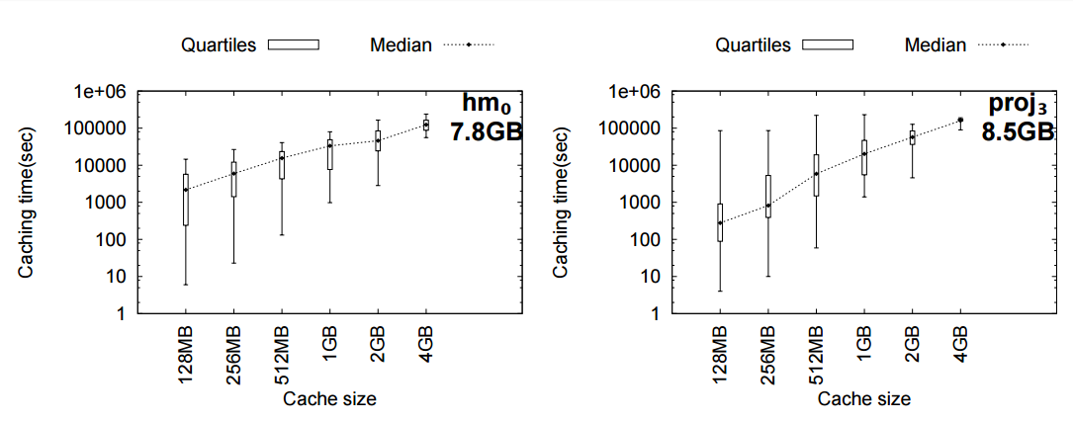
Introduction & motivation
Caching time
T(caching) = T(evict) −T(first)
75% of the data is less than 10⁵ seconds
Don’t need to ensure 10⁷ seconds retention capability in the cache
Distributed Computing Laboratory in SKKU

Slide 8
Introduction & motivation
retention capability 을 낮춰서 Write Performance를 Improve 할 수 있는 cache를 제안
Distributed Computing Laboratory in SKKU

Slide 9
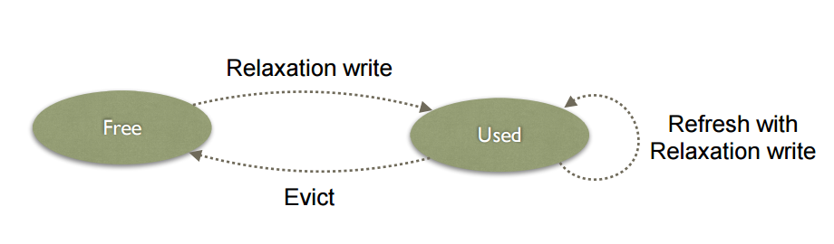
Design - REF
REF(REFresh-based cache management scheme)
REF is similar to the LRU scheme
Higher retention increasing write latency
Enhances write speed by relaxing retention capability from 10⁷ to 10⁴
Problem
Refresh operation, additional write
Distributed Computing Laboratory in SKKU

Slide 10
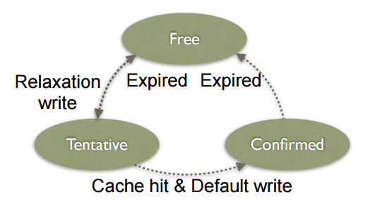
Design - SACM
Simple Amnesic Cache Management
Free State to Tentative State
Initial write into the cache, the data is written with the relaxed write(10⁴)
Tentative State to Confirmed State
If it is referenced again within the retention time
It is rewritten with 10⁷ retention capability
Confirmed State to Free State
If it is not referenced again and
the retention time expires
Problem
Additional writes
Distributed Computing Laboratory in SKKU

Slide 11
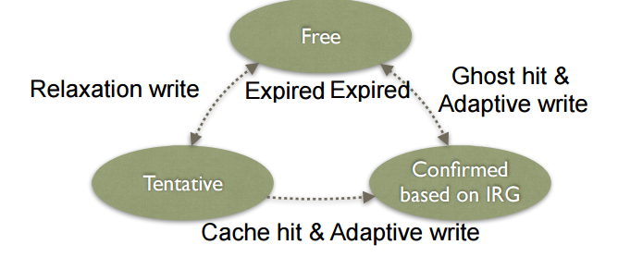
Design - AACM
Adaptive Amnesic Cache Management
Estimates the next reference of each data and adaptive write
Adaptive write
Ensure appropriate retention capability adaptively for each data
Problem
Adaptive write and Estimation
Distributed Computing Laboratory in SKKU

Slide 12
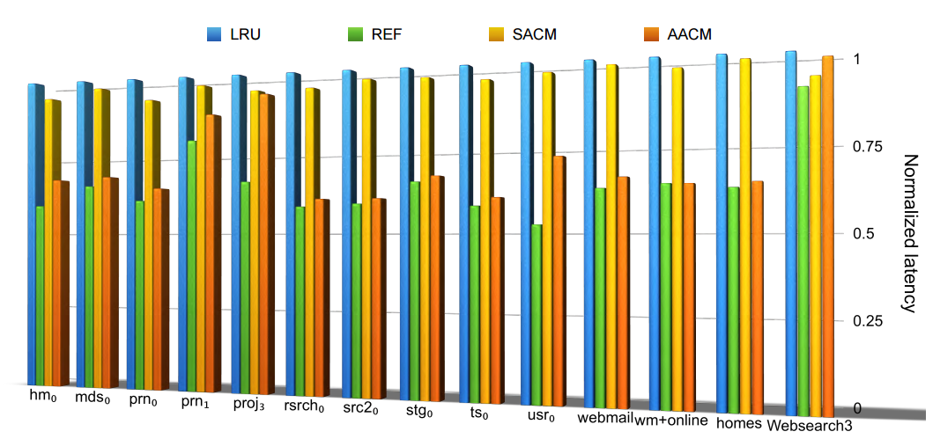
Evaluation
latency
REF reduces 48% (36% on average)
SACM 7% (4% on average)
AACM does it up to 40% (30% on average)
Distributed Computing Laboratory in SKKU

Slide 13
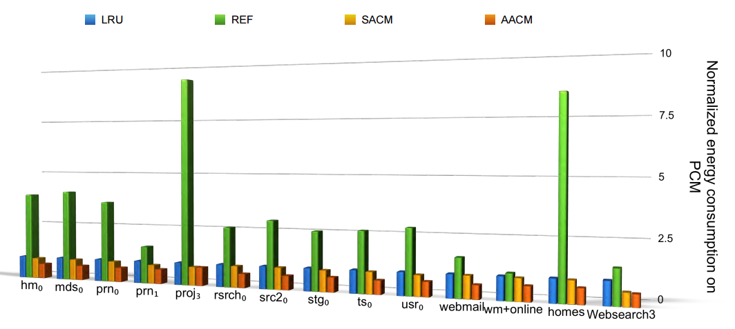
Evaluation
Energy consumption
REF is 9 times higher than LRU (refresh overhead)
Distributed Computing Laboratory in SKKU

Slide 14
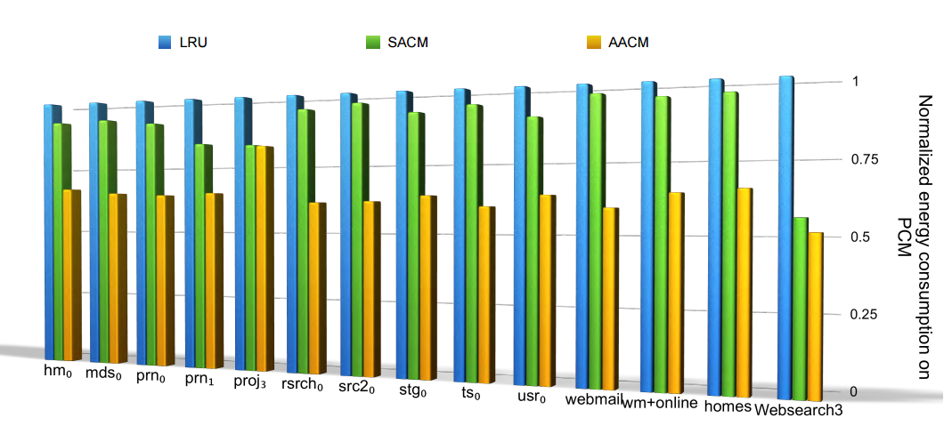
Evaluation
Energy consumption (without REF)
SACM reduces energy consumption on average 11%
AACM saves energy consumption on average 37% (and as high as 49%)
Distributed Computing Laboratory in SKKU

Slide 15
Conclusion
Conclusion
We suggest “Amnesic notion”
Exploit limited retention capability
Experimental results show that our proposal is effective in terms of
performance and energy consumption.
AACM can reduce write latency by up to 40% (30% on average)
Also, AACM save energy consumption by up to 49% (37% on average)
Distributed Computing Laboratory in SKKU

Slide 16
감사합니다
Distributed Computing Laboratory in SKKU

